Slide 1
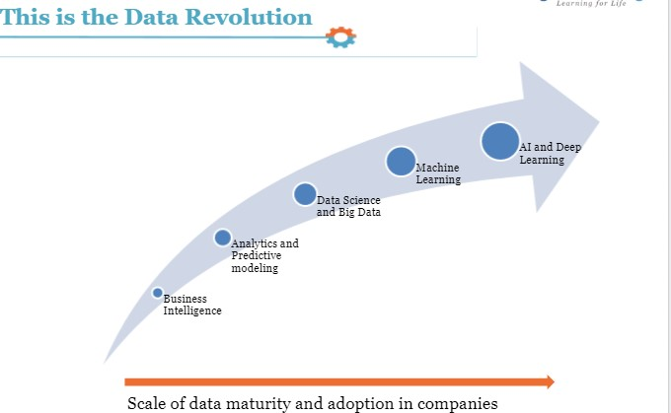

Slide 2
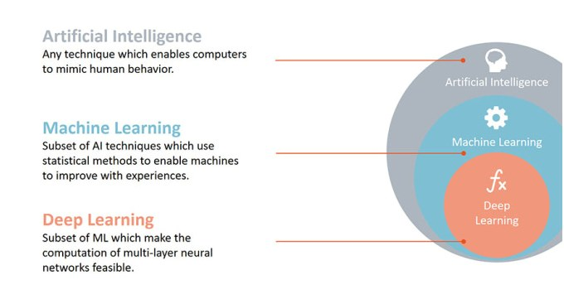
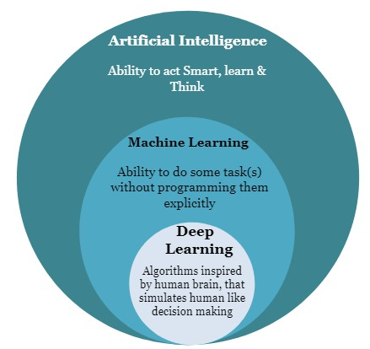

Slide 3
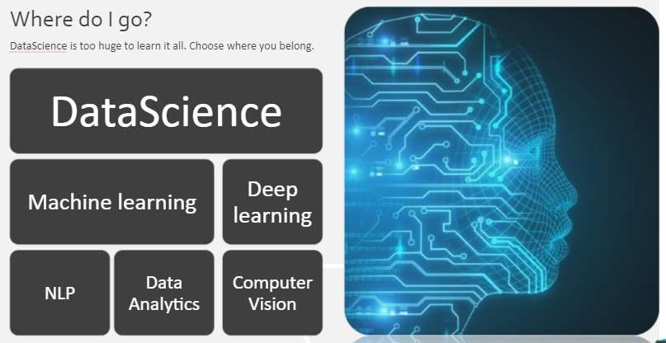

Slide 4
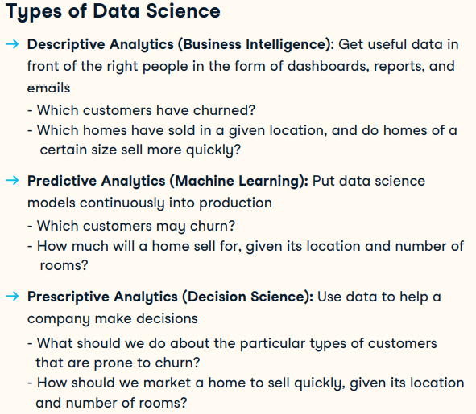

Slide 5
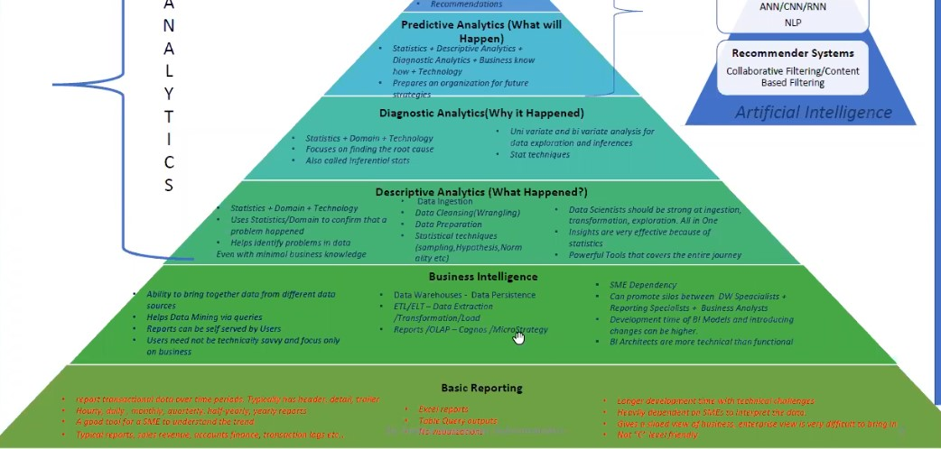

Slide 6
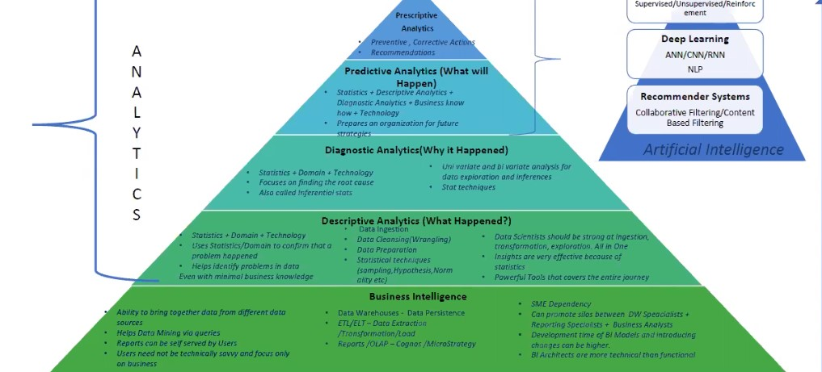

Slide 7
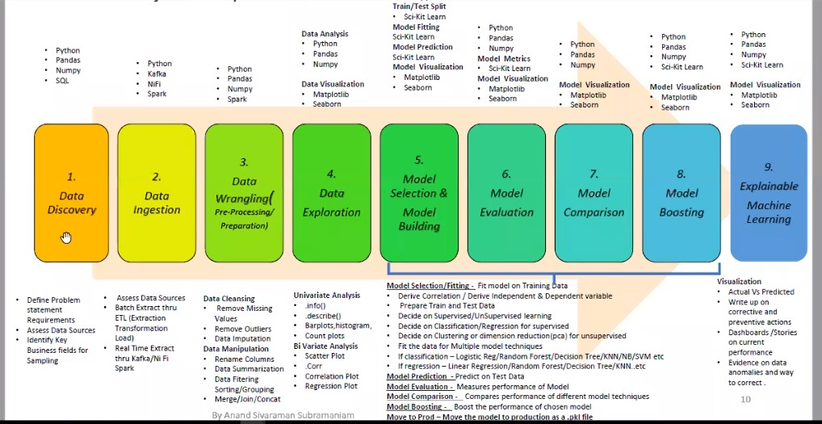

Slide 8
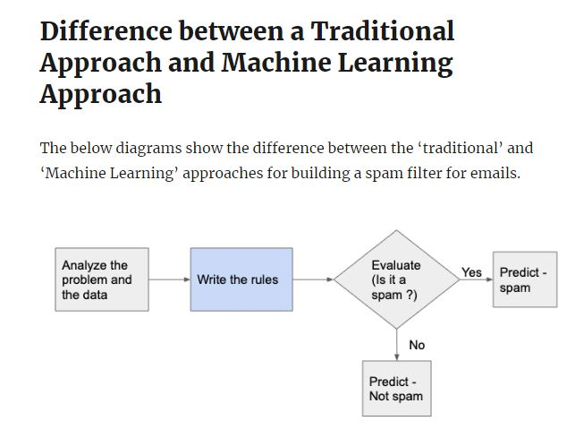
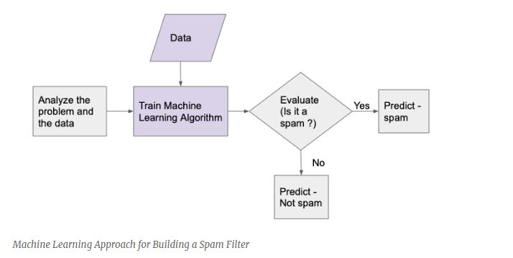

Slide 10
Data Analysis
Feature Extraction
Data Wrangling
Exploratory Data Analysis
Programming Language
Python
R
Java
Machine Learning
Classification
Regression
Reinforcement
Deep learning
Dimensionality Reduction
Data Science
IDE
Pycharm
Jupyter
Colab
Spyder
Data Visualization
Matplotlib, Seaborn
Tableau
Power BI
Maths
Statistics
Linear Algorithm
Differential Calculus
Llibrary
Scikit-learn
Numpy
Scipy
Pandas
Web Scraping
Beautiful Soup
Scrapy

